Slide 1

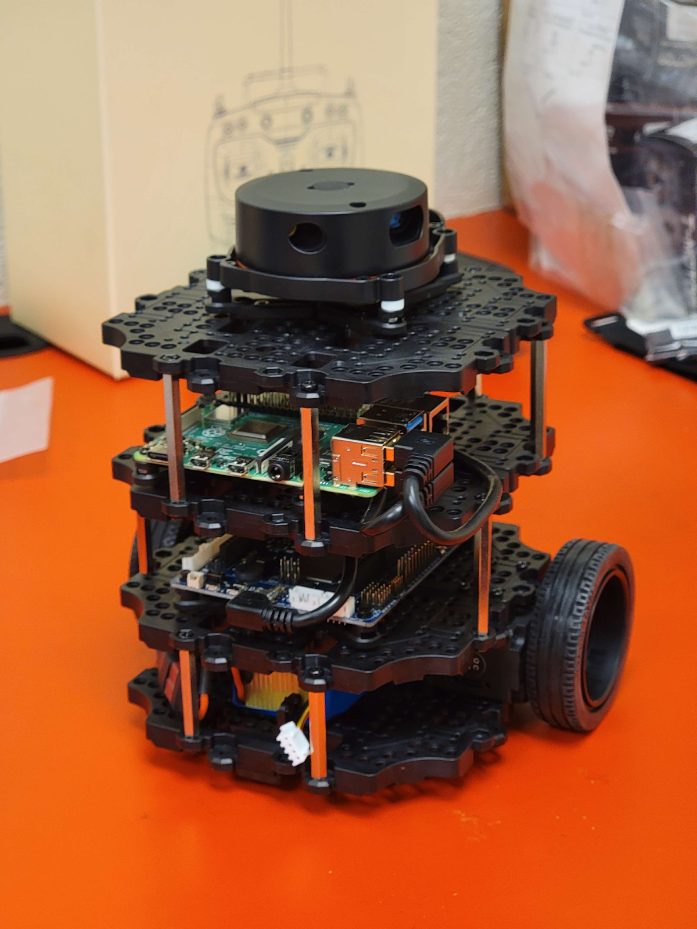
NibblesBot
Ethen Carrell
Charles Moertle
Calab Reeder

Slide 2



Problem

Slide 3
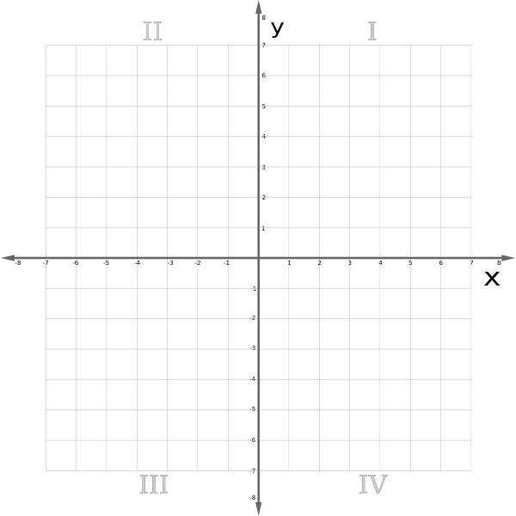
There is more to it than you think
What are actions that humans do intuitively?
How do you find objects and recognize patterns?:
How do you know that they are different?
How would a robot know?
How does a robot know where it is in the world?
Frame of Reference

Slide 4
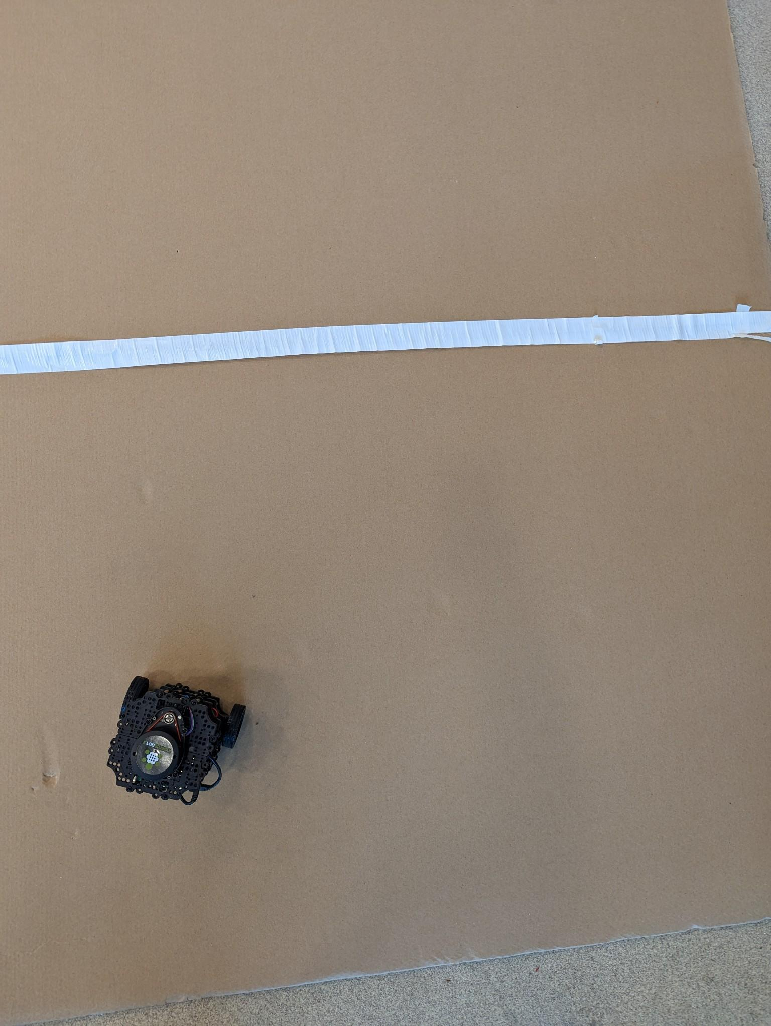
Designing the Environment
Cardboard environment
Overhanging Camera (God Cam)
Tape will be used for walls

Slide 5
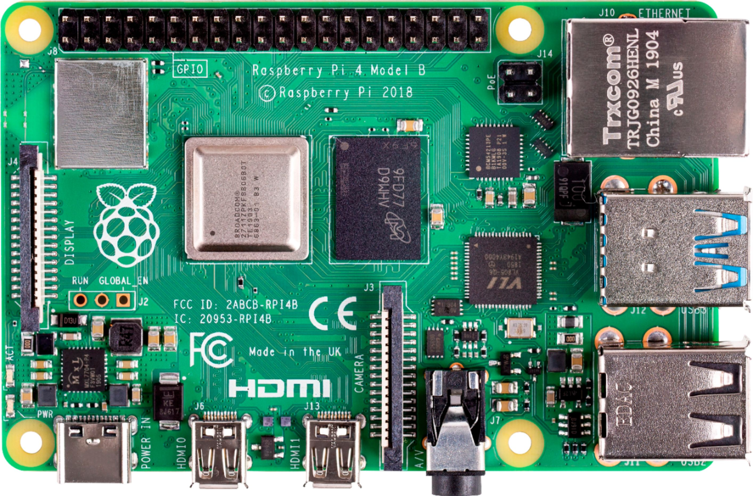
Robot Design
Drive systems
LiDAR
Pi 4 B

Slide 6
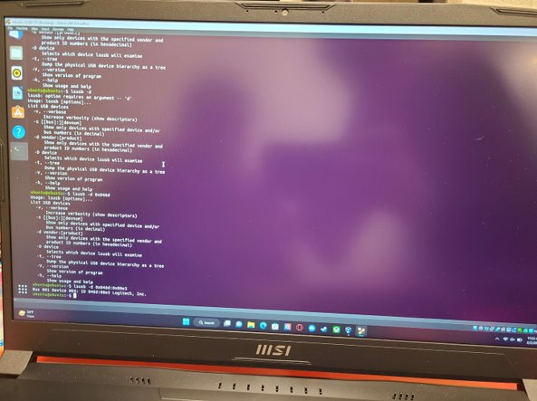

ROS
ROS Noetic
Networked ROS

Slide 7
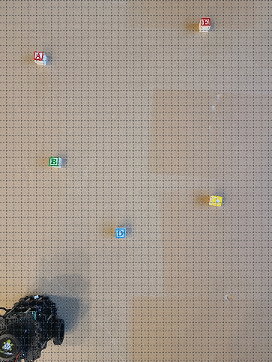
Computer Vision
Create objects based on blocks and robot
Robot:
Coordinates
Orientation
Blocks:
Coordinates
Symbol
Color
Where to arrange blocks...

Slide 8
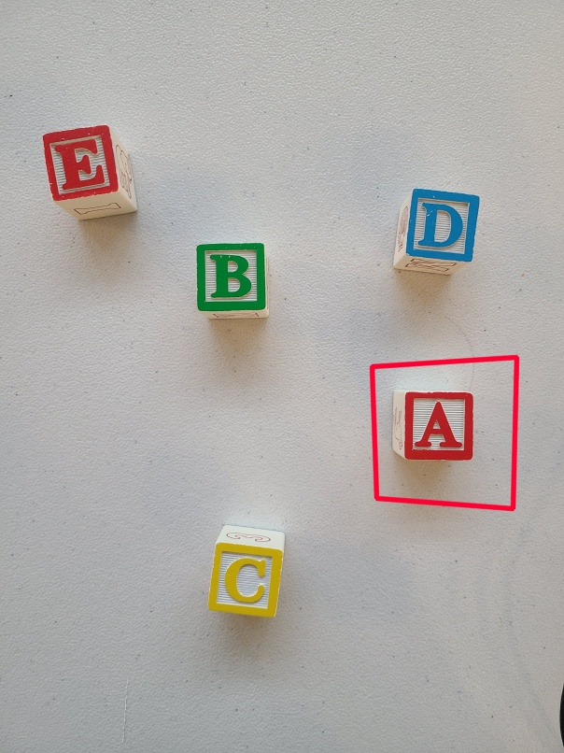
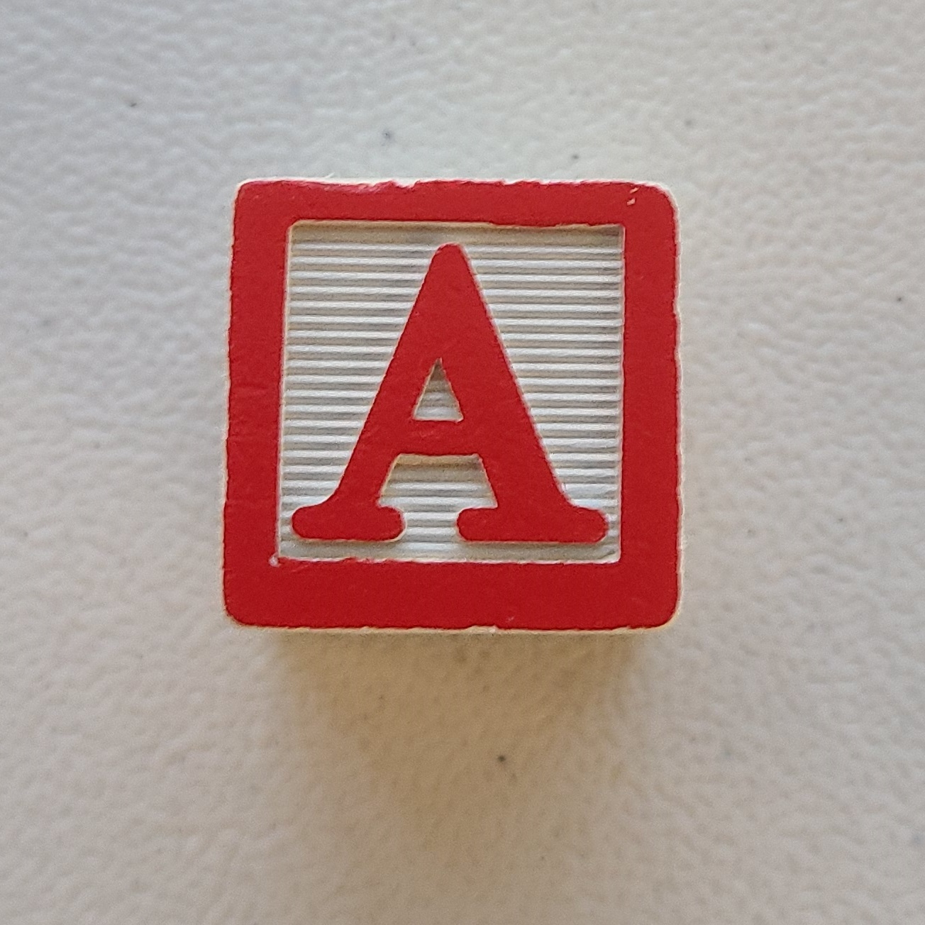
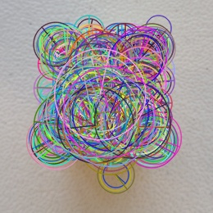
Computer Vision
Testing Image
Using ORB feature detection
Detect key points and compute descriptors from images
Initialize a Brute Force Matcher
Draw bounding box in testing image
Training Image
<- 1000 Features

Slide 9
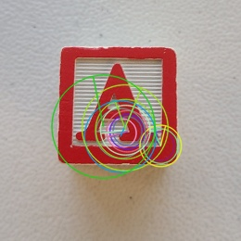
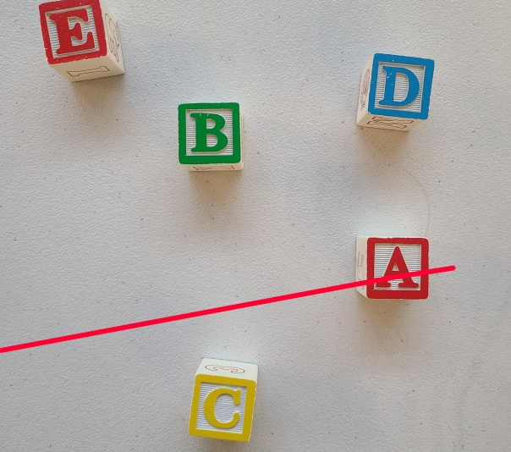
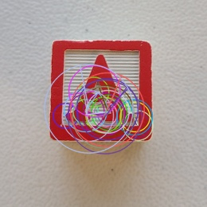
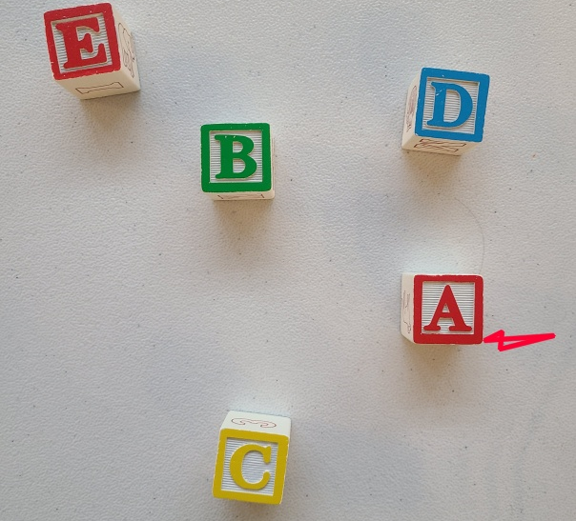
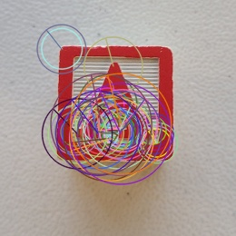

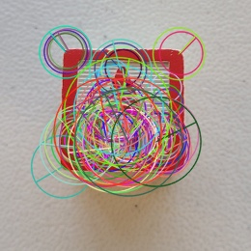

13 Features
25 Features
50 Features
100 Features

Slide 10
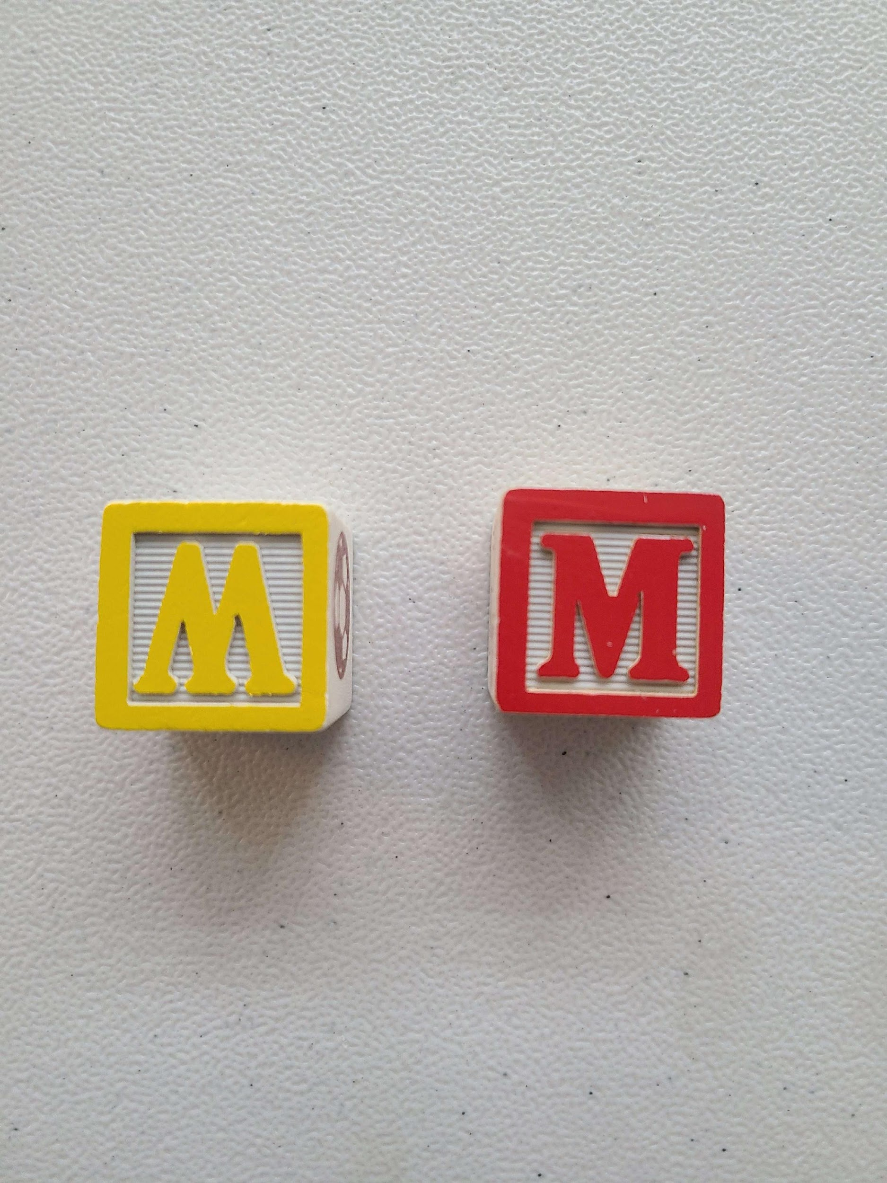
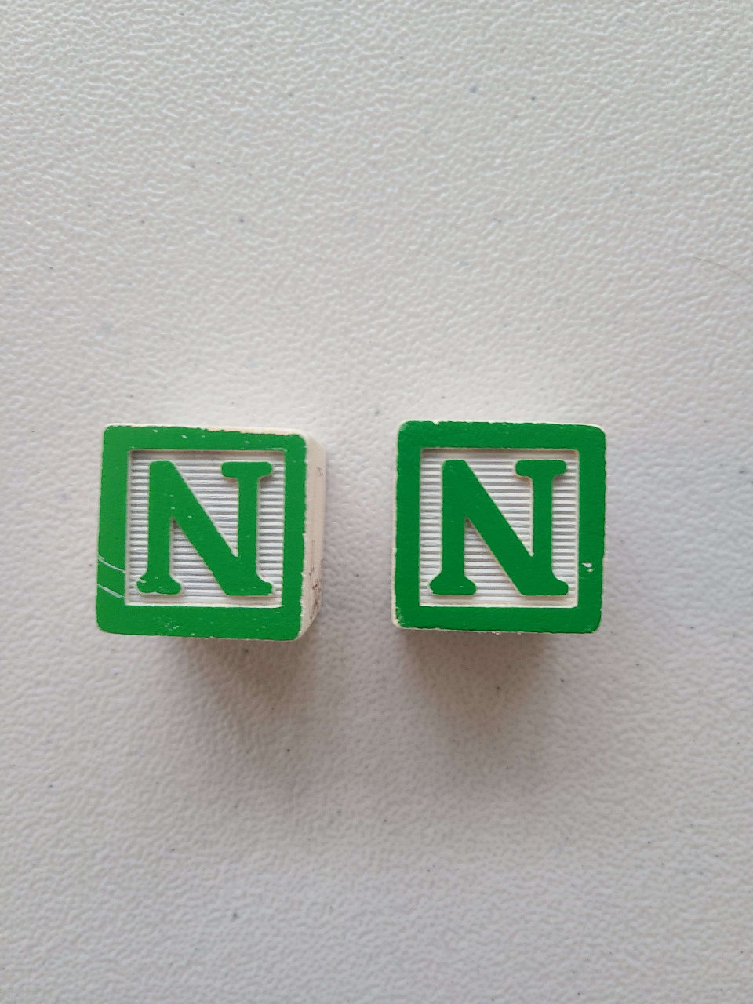
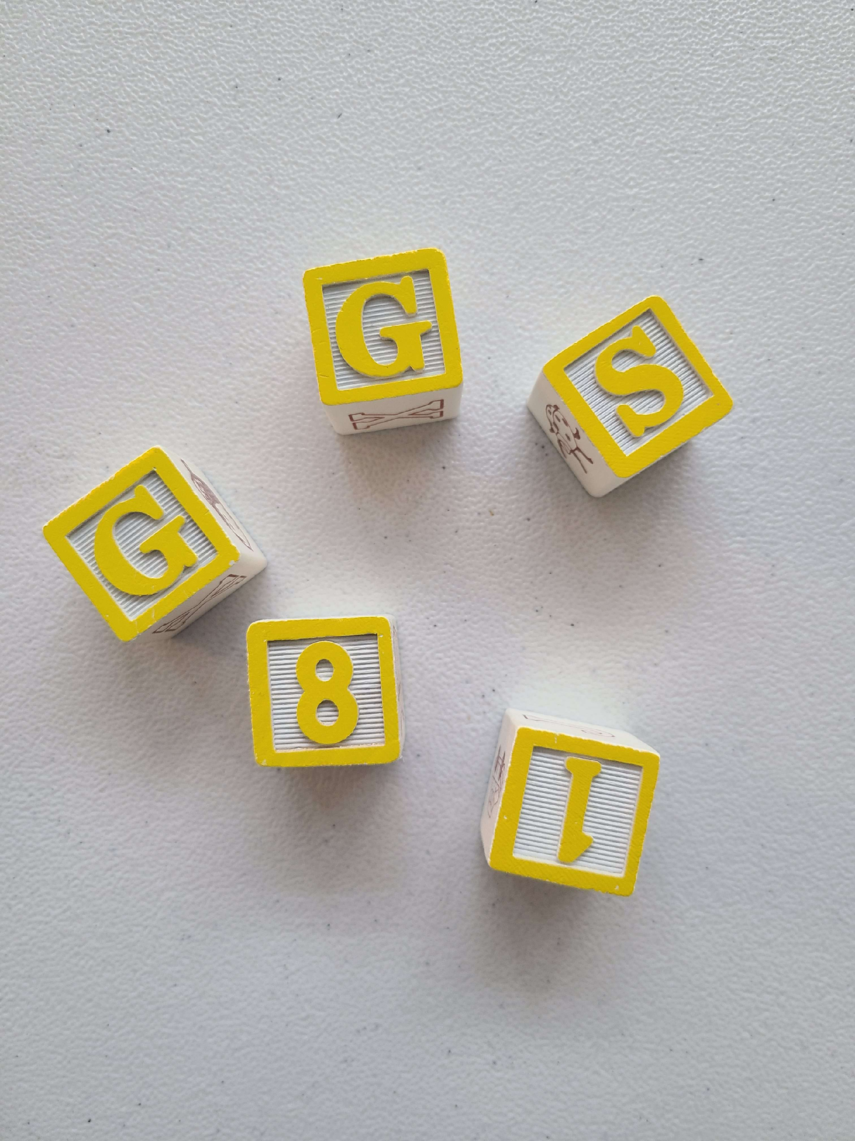
Computer Vision
Major issues with block detection:
Orientation
Similar letters
Colors
Duplicate letters

Slide 11
Sources
“Teach Ros Effectively.” The Construct, https://www.theconstructsim.com/for-campus/
Jagadeesan, Anandh. “Text Detection and Extraction Using Opencv and OCR.” GeeksforGeeks, 16 Sept. 2021, https://www.geeksforgeeks.org/text-detection-and-extraction-using-opencv-and-ocr/

